Slide 1
Innovators’ Initiative II - STEP
National Call Information Webinar I
Innovators Initiative is co-funded by the Government of Ireland and the European Union
through the ERDF Northern & Western Regional Programme 2021-2027 and
the ERDF Southern, Eastern & Midland Regional Programme 2021-2027

Slide 2
Contents
Welcome & Introduction to the Innovators’ Initiative
Innovators’ Initiative II - STEP : Programme Overview
STEP Priorities & Alignment Requirements
ERDF Funding Framework Overview
Lessons Learned from Current Programmes
Q&A Session

Slide 3
Welcome & Introduction to the Innovators’ Initiative

Slide 4
Innovators’ Initiative II – STEP : Programme Overview

Slide 5
What is the Innovators Initiative
The Innovators’ Initiative (II) is a national programme that supports the creation of immersive, needs‑led innovation training programmes hosted by publicly funded Research Performing Organisations (RPOs).
The programme equips high‑calibre participants with the skills and real‑world exposure needed to identify unmet needs, develop early-stage solutions, generate new IP, and explore commercialisation pathways — including potential creation of high‑potential start‑ups.

Slide 6
Current Programmes
BioInnovate – University of Galway: Needs‑led MedTech innovation with clinical immersion and team‑based training. Focused on identifying unmet healthcare needs and developing viable solutions.
DigiBio – DkIT, RCSI & Partners: Digital health innovation with an eight‑week clinical immersion and hands‑on training. Multidisciplinary teams supported by clinical, industry and technology experts.
CyberInnovate – Munster Technological University: Cybersecurity innovation targeting real‑world market and security challenges .Fellows receive needs‑led training and expert mentorship within MTU’s ecosystem.
FAST‑IP – UCD & Teagasc: Food and Agritech sustainability innovation tackling real food‑system challenges. Provides needs‑led training, sector exposure and leadership development

Slide 7
What is new in the second call
Shorter programme term: Programmes will be funded between 2027 and 2030 with 3 cohorts of participants trained through the academic years.
Different funding distribution across Ireland with funding similar to current Innovators’ Initiative programmes
Mandatory STEP Alignment: All proposals must directly support the development or manufacturing of critical technologies under the Strategic Technologies for Europe Platform (STEP), including:
Digital and deep technologies
Clean and resource‑efficient technologies
Biotechnology
Defence technologies

Slide 8
Programme term and timeline
1st Cohort
Start September 2027
Finish June 2028
2nd Cohort
3rd Cohort
Start September 2028
Finish June 2029
Start September 2029
Finish June 2030
Programme term is four years, 2027-2030 including a mid-term review.
Expenditures processed until end of calendar year for each participant cohort.

Slide 9
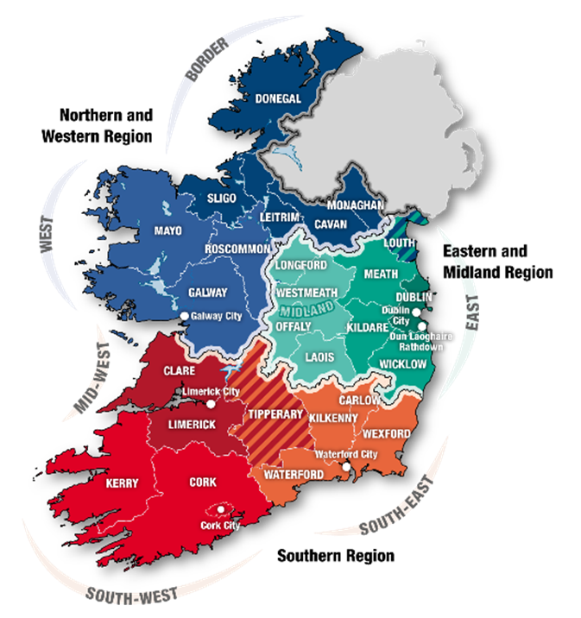
How is the funding distributed
1 Programme in the NWRA with €3.5 million in funding
2 Programmes in the SEM with €7 million in funding

Slide 10
Programme implementation timeline
Q4 2025
IRCC Decision
Q1 2026
EI Board Approval
Q2 2026
Call Launch
Complete evaluation
Q4 2026
Implementation plan draft and approval
Start evaluation of submitted applications
Funding awards to successful applicants pending EI Board approval
Letters of Offer issued
Advance payments issued
Pre evaluation
Q3 2026
PMC Approval for NWRA and SEM granted
Formal submission of programme amendment to European Commission
Formal approval of programme amendment by European Commission

Slide 11
Key Takeaways for Applicants
Proposals must show strong, credible alignment to STEP and regional S3 priorities.
The immersive environment is a core differentiator — it must be authentic, repeatable, and sector‑specific.
Robust governance and staffing, and are essential.
Programmes must clearly articulate how participants will be trained, supported, and guided into downstream commercialisation routes.
Early engagement with industry partners strengthens competitiveness.

Slide 12
STEP Priorities & Alignment Requirements

Slide 13

Strategic Technologies for Europe Platform (STEP)
Innovators Initiative II (STEP) – National Call 2 Information Webinar
Irati ICARDO ISASA- STEP Team– DG BUDG – EUROPEAN COMMISSION
https://strategic-technologies.europa.eu

Slide 14
In a nutshell
STEP
Not a new fund: pooling funding from 11 EU existing programmes, with a top-up of €1.5bn for defence
Efficient: use of existing networks/processes
STEP Seals awarded to high-quality projects
A service-oriented team to support STEP sectors
User-centric portal
A pilot for a new Competitiveness Fund as announced by Commission President
Regulation entered into force on 1 March 2024

Slide 15
Mobilising funds towards STEP

Slide 16

11 EU programmes support STEP
STEP
More than 100 calls €13.5bn
€14bn across 21 MS
5
6
EU PROGRAMMES⁽¹⁾
EU PROGRAMMES
Funding and STEP Seal awarded by the Commission
Funding allocated by Member States from the EU budget and financial institutions (e.g., EIB)
Horizon Europe⁽²⁾ | EU4 Health
Innovation Fund | European Defence Fund
Digital Europe Programme
Award of
STEP Seal
European Regional Development Fund | Cohesion Fund
European Social Fund + | Just Transition Fund
Recovery & Resilience Facility⁽³⁾ | InvestEU⁽⁴⁾
PROJECTS' FAST TRACK TO OTHER FUNDING
⁽¹⁾ Direct management: EU funding is managed directly by the Commission; shared management: the European Commission and national authorities jointly manage the funding; indirect management: funding is managed by partner organisations or other authorities inside or outside the EU
⁽²⁾ European Innovation Council
⁽³⁾ Performance based programme managed by the European Commission and implemented by the Member States
⁽⁴⁾ Implemented through the EIB group & other implementing partners – not awarding the Seal
Notes:
RRF: MS can allocate more support from RRF to InvestEU for STEP (additional 6% and up to 10% of their plans) - Deadlines shift to end 2028 for the implementation
Projects awarded the Seal to be considered in revision
OK with the slide with one request:
Put in a different color those funds which are sepcfiic to a sector: EU4Health, Innovation Fund, DEP
WHen presenting, do stress that:
-all these are funded by the EU budget with programmes on the left (managed directly by COM) much less endowed than those on the right (mostly managed with MS)
-we are aware of the complexity of the galaxy of funds today
-On the left, programmes are EU-wide, the best projects wins for the benefit of the Single Market as a whole. On the right, except for InvestEU, the envelope is allocated ithn each MS.
-How much PT is getting in cohesion funds and in RRF (loans + grants) that is then allocated by the Member STate according to common rules – do check for your backgrouind the state of play on RRF implementation in PT

Slide 17
STEP Scope
Objectives, conditions, and scope

Slide 18
Scope
STEP
STEP
OBJECTIVES
STEP
CONDITIONS
STEP
SECTORS
(indicative & non-exhaustive)
EXAMPLES
Supporting the development or manufacturing of critical technologies or safeguarding and strengthening their respective value chains | Bring an innovative, cutting-edge element with significant economic potential to the Single Market
Addressing shortages of labour and skills | Contribute to reduce or prevent strategic dependencies of the Union
Digital and deep tech innovation | Artificial intelligence, quantum technologies, advanced connectivity
Clean and resource efficient tech | Carbon capture and storage technologies, heat pumps
Bio tech | Molecular biotechnology, pharmaceuticals, crop biotechnology
Defence | All defence technologies, including dual-use
CRMA
NZIA
OR
NEW
*STEP Guidance notes published on 13 May 2024 and 23 December 2025
NZIA: Net-Zero industry Act
CRMA: Critical Raw Materials Act

Slide 19
Development and manufacturing in the EU
STEP OBJECTIVES
Skills that are relevant to the development and manufacturing of critical technologies.
Broader and transferable skills may only be supported via STEP if they are combined with STEP-specific skills (these skills on their own do not qualify as a STEP project.). Fund-specific rules apply.
TRL levels are indicative
Skills
TRL4 | TRL5 | TRL6 | TRL7 | TRL8 | TRL9
Fundamental research
(incl. TRL1-3)
Installation and deployment of the final products*
Development
Manufacturing
Activities aimed at achieving technological breakthroughs, perfecting the technology for market needs, including enhancing its efficiency, reliability, and developing standards.
Setting up production lines, first-of-a-kind-facilities, the extension or repurposing of existing facilities, scaling up processes to meet demand, and/or implementing quality control mechanisms to ensure the consistent production of high-quality products.
Unless:
Associated service
First-of-a-kind facility
Associated services are specialised services critical and specific to the development and manufacturing of final products in STEP sectors.
Ancillary services may only be supported via STEP if they are an inherent part of the investment cost of a STEP project (no standalone project). Fund-specific rules apply.
*Final products = completed technological solutions that emerge from the entire process of development and manufacturing
Notes:
First-of-a-kind facility refers to a manufacturing or production facility that, in its design and operation, demonstrates innovative and new technologies or processes. These facilities are characterised by the use of emerging or advanced technologies that have not been widely commercially deployed, either in the EU or globally.
Objectives essentIally dev and manufacturing, describe TRLs:
Fundamental research is not eligible under STEP – only applied research is
Feasibility of the technology has to be demonstrated
Development stands on TRL4-6/7: achieve technological breakthroughs, perfecting tech for market needs, enhance efficiency. Development activities should occur at a stage where feasibility was demonstrated (fundamental/theoretical research is excluded) and is linked to a STEP technology
Manufacturing: Setting production lines, scale up of processes, implementing quality control mechanisms, etc. Manufacturing activities typically occur at TRL8-9. At these levels, the focus shifts to the final stages of technology development, where the technology is fully integrated, tested, and validated in its intended operational environment (TRL 8). By TRL 9, the technology is ready for full-scale commercial production and deployment.
Installation and deployment: are not eligible under STEP:
Associated service: specialised equipment ; if want to procure equipment that is absolutely necessary – ould be considered as such. Avoid business as usual. Investing in critical tech.
FOAK with very strong innovation element linked to it.
Underline: text is from the guidance.
Delpoyment FOAK in DEP/ iNNOVATION Fund
Examples: lots of problems in the inustry is in scale up and deployment; we here for new tech and innovate.
Pilot lines can be included(TRL 8-9)

Slide 20
STEP CONDITIONS
Condition 1: Innovativeness
Innovative
Substantial impact on
development / manufacturing
At least two elements (innovative, emerging, cutting-edge)
Significant economic potential
Emerging
+
Addressing various Union markets
Cutting-edge
Positive spillover effects

Slide 21
STEP CONDITIONS
Condition 2: Strategic dependencies
UNION LEVEL ASSESSMENTS*
FACTORS
Industrial Policy Update
Industrial and technological leadership
Observatory of critical technologies
Critical infrastructures at European level
At least two factors should be considered
Action plan on civil, defence and space
Increasing manufacturing capacity**
European Economic Security Strategy
Strengthening
security of supply
EU list of critical medicines
Promoting positive
cross-border effects in the internal market
*a strategic dependency may also be deemed to exist where the European Union relies significantly on third-countries sources of supply for a technology under a STEP sector
**where there is a risk of strategic dependency in the Union

Slide 22
Digital and deep technologies
STEP SECTORS
Advanced semiconductors technologies | Microelectronics, photonics, high frequency chips, semiconductors,etc.
Artificial intelligence technologies | AI algorithms, high performance computing, analytics technologies, etc.
Quantum technologies | Quantum computing, quantum key distribution, quantum simulation, quantum imaging, etc.
Advanced connectivity, navigation, and digital technologies | Secure digital communications and connectivity, such as RAN (Radio Access Network) & Open RAN (Radio Access Network), and 5G and 6G; cyber security technologies including cyber- surveillance, security and intrusion systems, digital forensics, etc.
Advanced sensing technologies | Electro-optical, radar, chemical, biological, radiation and distributed sensing;, etc.
Robotics and autonomous systems | Autonomous habited and uninhabited vehicles (space, air, land, surface, and underwater), including swarming; robots and robot-controlled precision systems, etc.

Slide 23
Clean and resource efficient technologies 1/2
STEP SECTORS
Solar technologies | Solar photovoltaic technologies; solar thermal electric technologies; solar thermal technologies; other solar technologies
Onshore wind and offshore renewable technologies | Onshore wind technologies; offshore renewable technologies
Battery and energy strorage technologies | Battery technologies; energy storage technologies
Heat pumps and geothermal energy technologies | Heat pump technologies; geothermal energy technologies
Hydrogen technologies | Electrolysers; hydrogen fuel cells; other hydrogen technologies
Sustainable biogas and biomethane technologies | Sustainable biogas technologies; sustainable bio-methane technologies
Carbon capture and storage technologies | Carbon capture technologies; carbon storage technologies
Electricity grid technologies | Electricity grid technologies; electric charging technologies for transportation; technologies to digitalise the grid; other electricity grid technologies
Nuclear fission technologies | Nuclear fission energy technologies; nuclear fuel cycle technologies
Sustainable alternative fuels technologies | Sustainable alternative fuels technologies

Slide 24
Clean and resource efficient technologies 2/2
STEP SECTORS
Hydropower technologies | Hydropower technologies
Other renewable energy technologies | Osmotic energy technologies; ambient energy technologies, other than heat pumps; biomass technologies; landfill gas technologies; other renewable energy technologies, etc.
Energy system-related energy efficiency technologies | Energy system-related energy efficiency technologies; heat grid technologies; other energy system-related energy efficiency technologies
Renewable fuels of non-biological origin technologies | Renewable fuels of non-biological origin technologies
Biotech climate and energy solutions | Biotech climate and energy solutions
Transformative industrial technologies for decarbonisation | Transformative industrial technologies for decarbonisation
CO2 transport and utilisation technologies | CO2 transport technologies; CO2 utilisation technologies
Wind and electric propulsion technologies for transportation | Wind propulsion technologies; electric propulsion technologies
Other nuclear technologies | Other nuclear technologies
Advanced materials, manufacturing and recycling technologies | Technologies for nanomaterials; smart materials; advanced ceramic materials; stealth materials; safe and sustainable by design materials; etc.
Technologies vital to sustainability such as water purification and desalination | Purification and desalination technologies
Circular economy technologies | Technologies for the reuse and recycling of electronics (e-waste); circular bioeconomy technologies

Slide 25
Biotechnologies
STEP SECTORS
DNA/RNA | Genomics; pharmacogenomics; gene probes; genetic engineering; DNA/RNA sequencing/synthesis/amplification; gene expression profiling,etc.
Proteins and other molecules | Sequencing/synthesis/engineering/manufacturing of proteins and peptides (including large molecule hormones); improved delivery methods for large molecule drugs, etc.
Cell and tissue culture and engineering | Cell/tissue culture; tissue engineering; cellular fusion; marker assisted breeding technologies; etc.
Process biotechnology techniques | Fermentation using bioreactors; biorefining; bioprocessing; bioleaching; biopulping; biobleaching; biodesulphurisation; bioremediation; biosensing; biofiltration and phytoremediation; molecular aquaculture; etc.
Gene and RNA vectors | Gene therapy; viral vectors
Bioinformatics | Construction of databases on genomes; protein sequences; modelling complex biological processes; including systems biology; etc.
Nanobiotechnology | Application of the tools and processes of nano/microfabrication to build devices for studying biosystems and applications in drug delivery, diagnostics, manufacturing, etc.

Slide 26
Defence technologies
STEP SECTORS
Air and missile defence | Integrated multi-layered air and missile defence systems, interceptors, detection systems (radars)
Artillery and precision strike | Artillery systems, long-range precision strike, advanced munitions
Missiles and ammunition | Guided missiles and ammunition, conventional munitions, warheads, propellants
Drones and counter-drones | UAVs (all classes), swarming systems, jammers, anti-UAV systems
Strategic enablers | Space assets and their protection, space situational awareness, space-based services such as Earth Observation, PNT and secure communications, critical infrastructure protection, energy security
Cyber, AI and electronic warfare | AI for command and control, cyber-defence, information warfare, electromagnetic spectrum operations, including electronic warfare suites, digital transformation of armed forces, optronics and radiofrequency systems
Military mobility | Warehousing and engineering capabilities, sustainable and agile logistics, additive manufacturing for combat maintenance
Ground combat | Close fire support systems, soldier systems, manned and unmanned ground systems
Maritime | Maritime situational awareness, surface and underwater combat manned and unmanned systems, seabed and anti-submarine warfare systems
Air combat | Air combat systems, airborne early warning, tactical and strategic air transport systems, rotorcraft, air-to-air refuelling
Medical (incl. countermeasures) | CBRN warfare including dedicated sensors and protective, decontamination and recovery systems

Slide 27





Practical examples – Electric vehicles
STEP
Development or manufacturing of electric propulsion systems / battery technologies
Why on scope?
Develops/manufactures a technology
Sector compliant: clean and resource efficient tech
What else do we need to demonstrate?
Compliance with 1 of the STEP conditions!
Broad production of the electric vehicle, or other peripheral activities such as paint shops
Why not on scope?
No development/manufacturing activities
Electric Vehicles alone are not within a STEP technology area/sector

Slide 28


Is my project aligned with STEP? self assessment
OBJECTIVES: Project supports the development or manufacturing of critical technologies, or safeguards and strengthens their respective value chains, and addresses shortages of labour and skills?
Not STEP
Complies with at least one CONDITION (innovativeness or reduces dependencies)
Not STEP
Within STEP SECTORS? (digital and deep tech, clean and resource efficient tech, biotech, defence tech
Not STEP
STEP-relevant

Slide 29




Common misunderstandings on STEP scope
STEP
Deployment of existing technologies instead of the development or manufacturing
Actions on fundamental research and whose feasibility has not been tested
Equipment and infrastructure with no criticality/specificity to a STEP technology or not listed as associated service
Skills related to the sectors and not to the development of technologies
Notes:
3 Common mistakes: deployment, associated services, fundamental research. On top of it, skills linked to the sectors and not to the technologies.
Associated services - pay attention to the use – predominantly for STEP purposes.

Slide 30
The STEP Portal

Slide 31
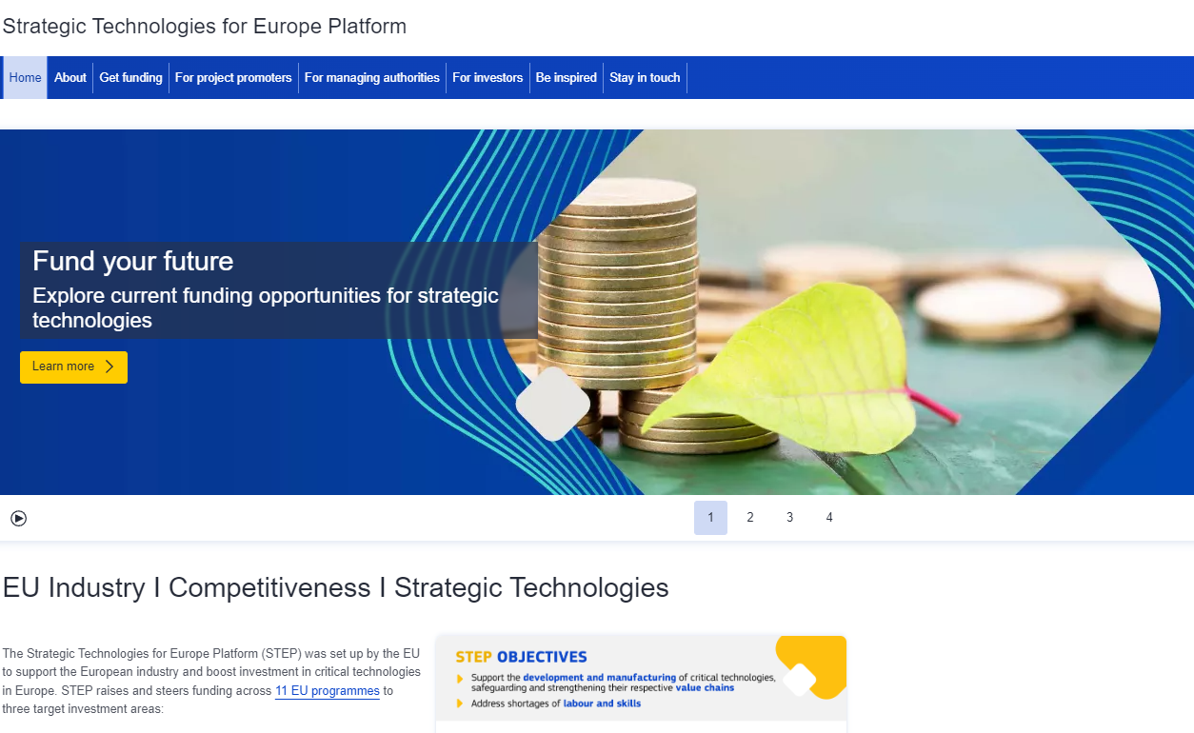
Portal : Central access point for users
STEP

Slide 32
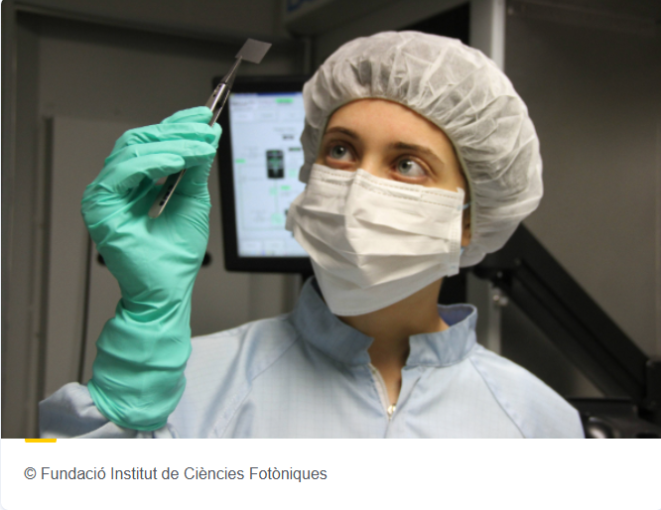

STEP Stories – digital and deep tech (ERDF)
PhotonChip: Covering the whole value chain of photonic technologies
PhotonChip is a platform project that will help bring photonic technologies, in particular integrated photonics and photonic chips, from scientific feasibility to prototype stage to be applied in, for instance, communications as 6G transceivers, sensors, quantum computing and technology platforms.
Catalonia, Spain

Slide 33
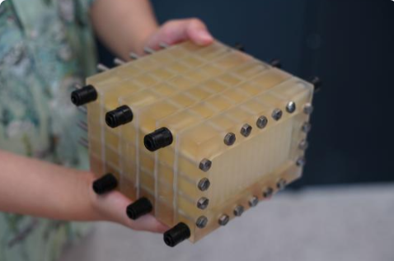
STEP Stories – clean/resource efficient tech (JTF)
FiBrane: Research project for offshore Green H2 Production
FiBrane is a groundbreaking method for efficiently transforming seawater into ultrapure water (UPW) needed for offshore green hydrogen production.
Denmark

Slide 34

STEP Stories – biotechnologies (EU4Health)
RoboPharma - Agile Pharmaceutical Manufacturing
AI to strengthen our medicine supply chain - This project develops an AI and robotic driven, decentralised pharmaceutical EU manufacturing platform to enhance crisis preparedness.
Italy

Slide 35
STEP Stories – skills for critical technologies
Transfer of skills and training for a new class of skilled quantum computer professionals ready to enter the world of work (Italy)
Support the development of specialised skills essential for the development of clean and resource-efficient technologies ( through lifelong learning, education and training projects)
Higher –Education training: short and long-term Bachelor level/Master/PhD programmes in STEP critical technology development in software engineering, data science, blockchain, AI, robotics, cybersecurity, deep learning, sustainable energy solutions, energy efficiency, smart grids, environmental engineering, biotechnology and biomedical sciences, bio-engineering, etc.

Slide 36




Thank you
Contact us at EC-STEP-PARTNERS@ec.europa.eu
More info on STEP: strategic-technologies.europa.eu
STEP Guidance Note I and Guidance Note II
Defence mini-omnibus
STEP Seals Dashboard
STEP Newsletter

Slide 37
ERDF Funding Framework Overview
Karen Coughlan, ERDF Compliance Enterprise Ireland
Innovators Initiative is co-funded by the Government of Ireland and the European Union​ through the ERDF Northern & Western Regional Programme 2021-2027 and​ the ERDF Southern, Eastern & Midland Regional Programme 2021-2027​
​

Slide 38
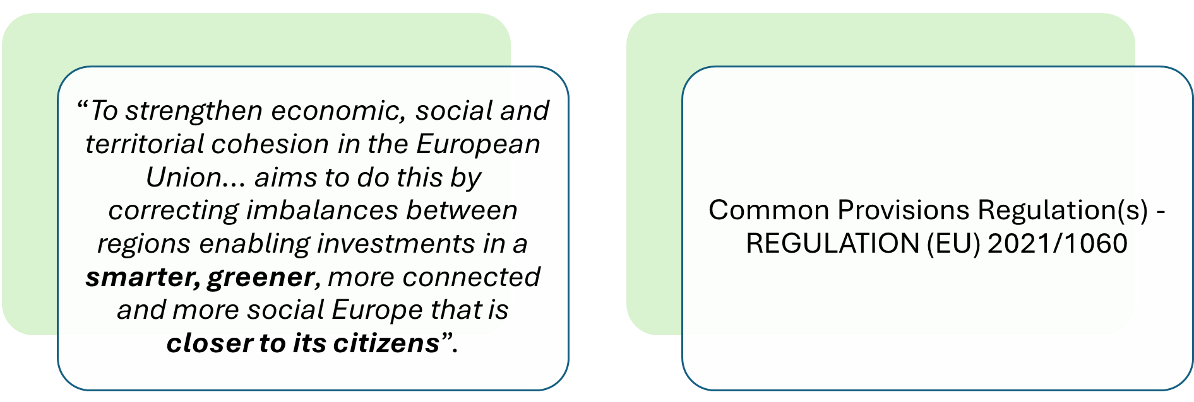
European Regional Development Fund (ERDF)

Slide 39



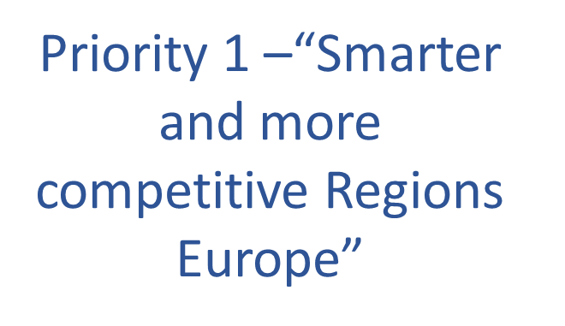


ERDF Programme Priorities

Slide 40
ERDF Regional Programmes in Ireland
Northern & Western Regional Programme 2021-27
€217m
Region in Transition
60% ERDF co-financing rate
Managing Authority = Northern &
Western Regional Assembly
Southern, Eastern & Midland Regional Programme 2021-27
€663m
More Developed Regions
40% ERDF co-financing rate
Managing Authority = Southern Regional Assembly

Slide 41
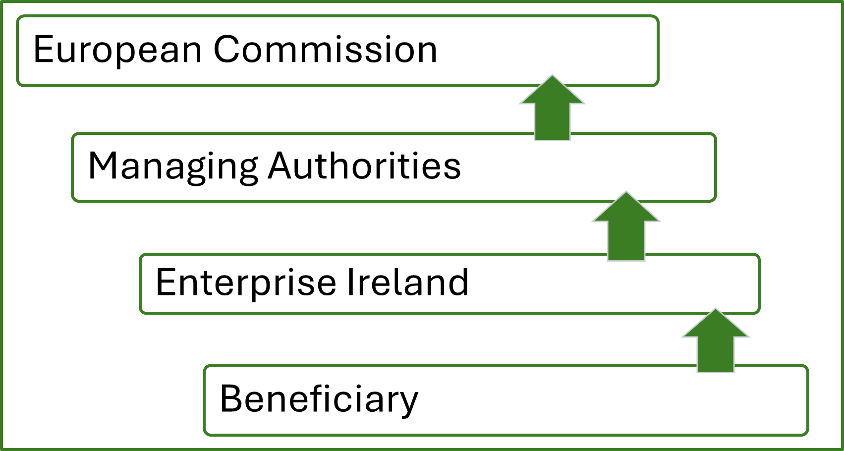
ERDF Reporting Cascade

Slide 42

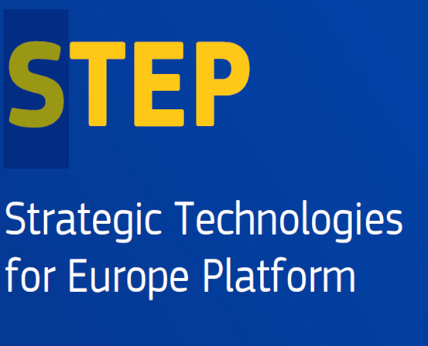


Eligibility for Innovators Initiative II
Proposals must demonstrate clear alignment with one or more eligible STEP technology areas AND alignment with the appropriate regional priorities in Irelands Smart Specialisation Strategy (S3)
Direction of funding

Slide 43
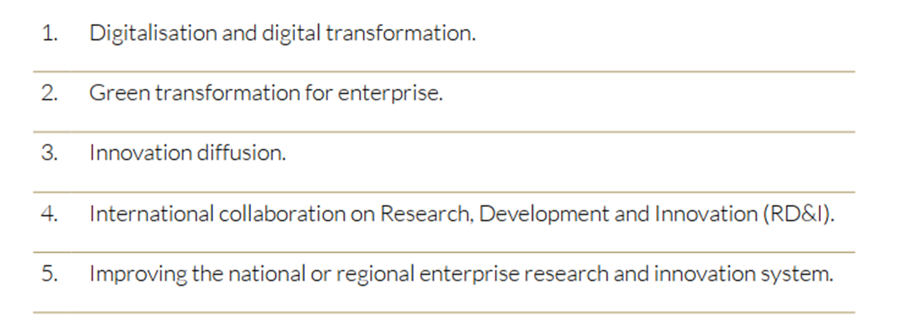
S3 National Strategic Priorities

Slide 44
Northern and Western Region | Eastern and Midland Region | Southern Region
Sectoral Strengths and emerging areas of opportunity
Advanced Manufacturing and Engineering | Advanced Manufacturing | Advanced Manufacturing
AgriFood and AgriTech | Audiovisual | Automotive/Aerospace
Audiovisual/Creative | Biopharma/Life Sciences | Design
ICT and ICT Services | Engineering | Financial Services
Life Sciences, MedTech and Medical Devices | Financial Services/FinTech | Food/AgriTech
Marine and Blue Economy | Food/AgriTech | ICT
Renewable energy, Climate Change mitigation and sustainability | ICT | Marine/Maritime
 |  | Pharma/MedTech
 |  | Renewable Energy

Slide 45
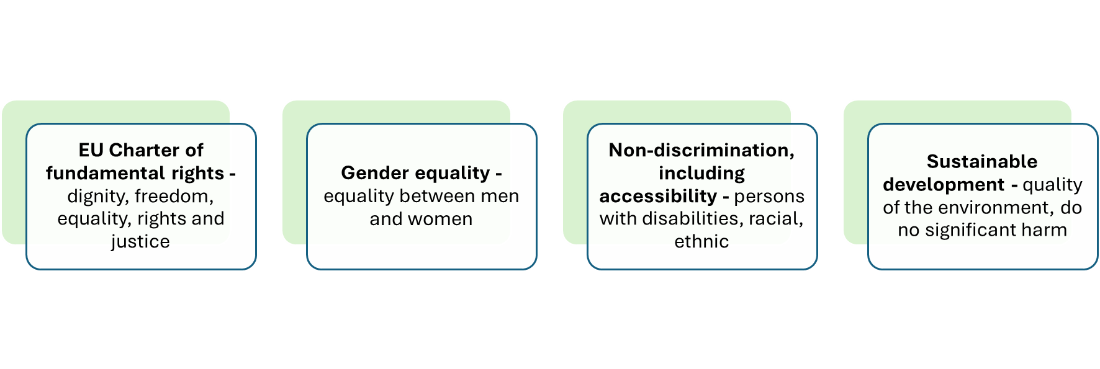
Respect and report on the Horizontal Principles
Horizontal principles are covered in EU funding legislation
Considered as “enabling conditions” – in case of non-fulfilment, Member States will not be able to send payment claims to the Commission for EU-funded projects related to unfulfilled preconditions
“shall be taken into account throughout the preparation and implementation of programmes.”

Slide 46
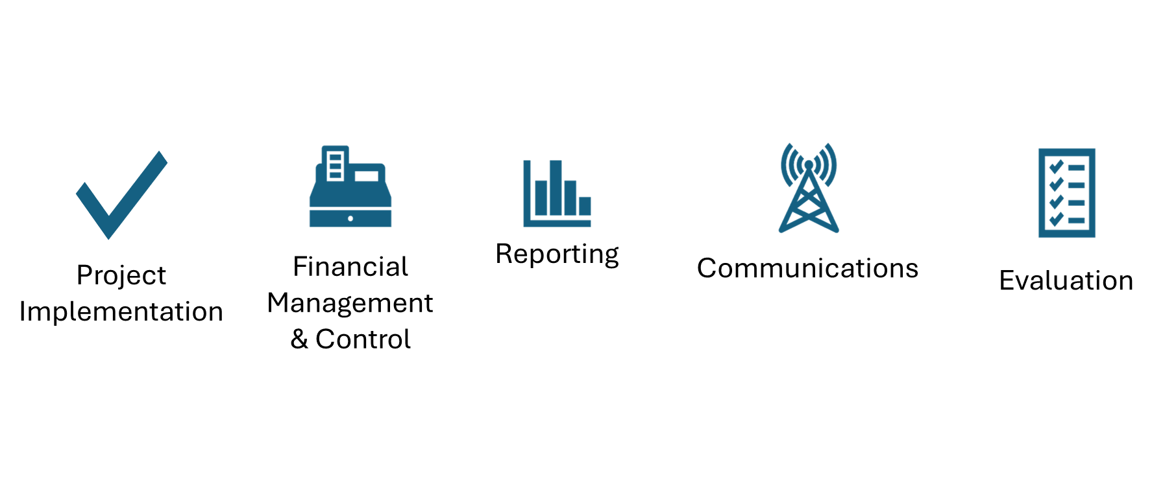
Beneficiary Responsibility

Slide 47
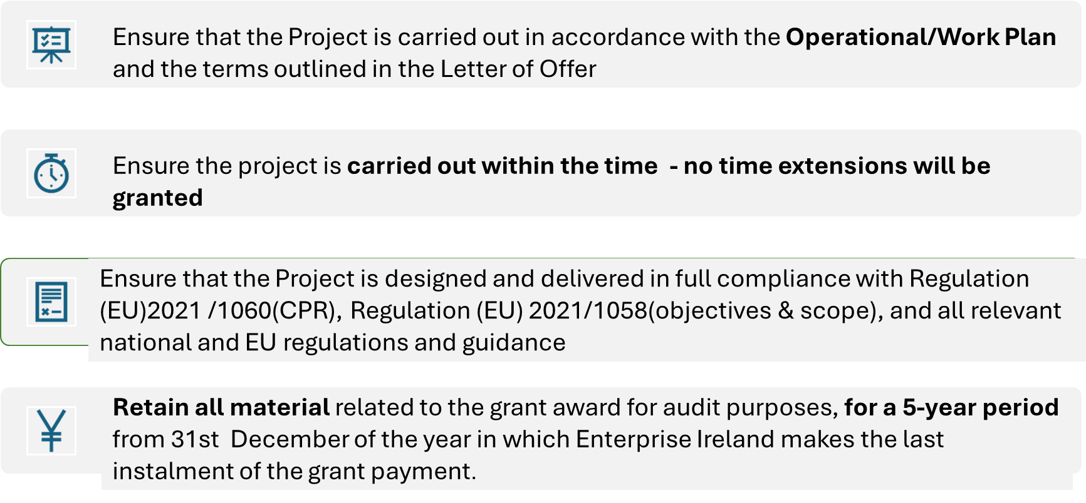
Project Implementation

Slide 48
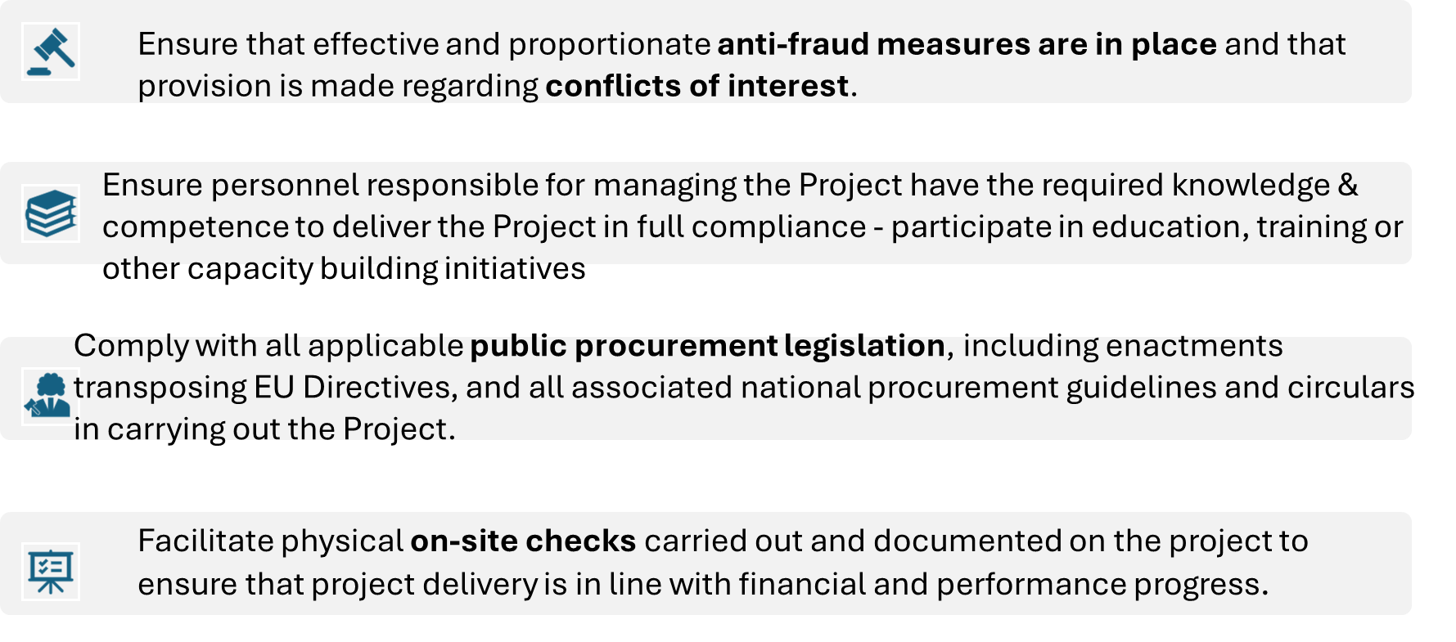
Project Implementation ​

Slide 49
Financial Management & Control Requirements
Ensure systems in place for timely declarations of eligible expenditure (incurred and paid) for the purposes of recouping ERDF funding on the designated IT system (ePPM)
Ensure systems in place to maintain a clear audit trail in relation to ERDF co-funded expenditure:
Ensure a separate accounting code for each project.
Ensure there is no overlapping of funding from other EU sources.
Ensure systems in place to retain original supporting documentation in accordance with the document retention period

Slide 50
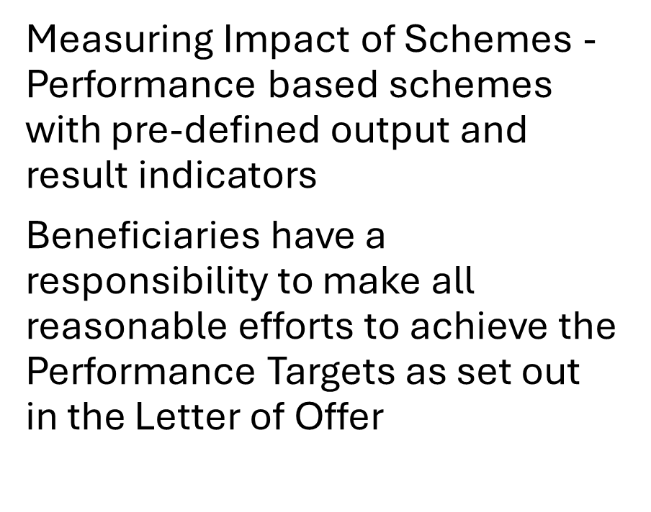
Reporting Progress
Indicator Code | Indicator | Measurement unit
PS001 | Number of participants completing a needs-led innovation training programme | Participants
PSR03 | Licensed Technologies | Intellectual Property Licenses
PSR06 | Number of HPSUs created as a result of the completed training | Enterprises

Slide 51

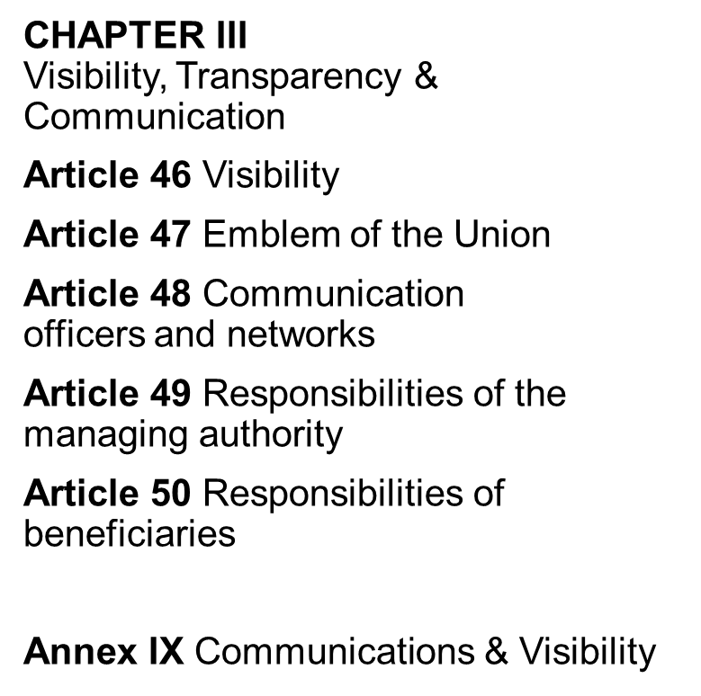

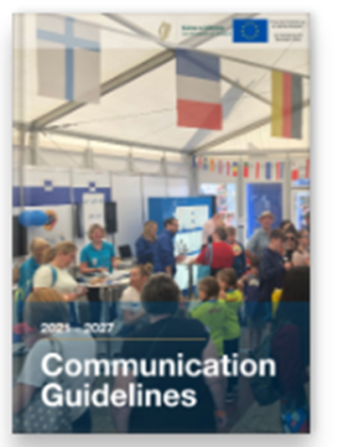

Communications Regulations
Sanction for non-compliance is up to 3% of funding.

Slide 52
Lessons Learned from Current Programmes

Slide 53





Lessons Learned Innovator’s Initiative
19th March 2026
Ronan Coleman
Director of Cyber Innovate
#euinmyregion
www.cyberinnovate.ie

Slide 54
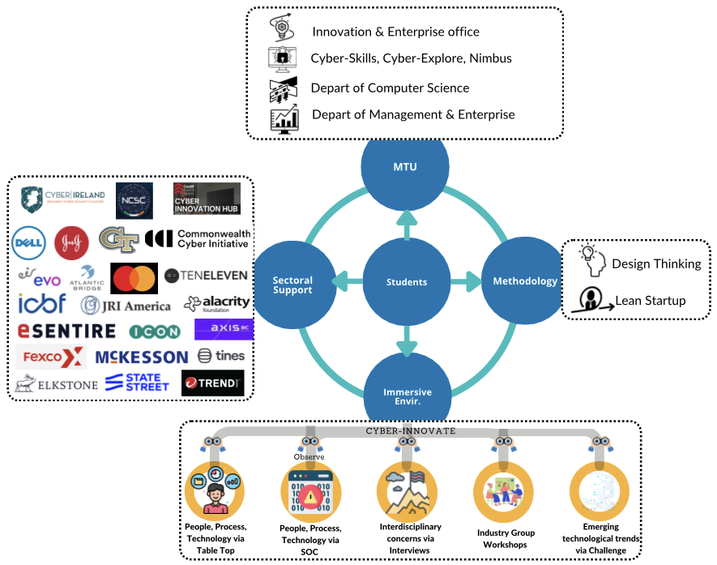
PG Dip in Cybersecurity Innovation
Programme Overview
Participants develop the skills to identify, evaluate, rank, select and validate needs for new products, solutions & services that will contribute to the creation of new cyber security SMEs/HPSUs
Achieved via a specially designed cyber security immersive environment and proven innovation methodologies
www.cyberinnovate.ie
Notes:
Immersive Environment
Expert Interviews – Main source of needs. Addition of the NCSC in Year 3 will add a new dimension to the types of needs identified
SOC visits
Tabletop Exercises
CTF competition
Industry Groups – Local Authorities, SMEs, MSPs/MSSPs
Conferences – Cyber Ireland, NCSC, Cyber Summit
Guest Speakers – 20+ each Semester

Slide 55
Effective programme design
Media splurge/launch event at the start – hit the ground running
Programme validation – big challenge in MTU
  Understand your internal processes
  Summer can be difficult
Build flexibility into your design
  You won’t know what will really work until you try it
  Be careful with staff on this
    I’m happy with chaos, some of colleagues are not
Recruitment is a BIG task – think about how you will attract suitable candidates and budget for it

Slide 56
Immersive learning environments
Credible design
Must be able to see/hear real problems and deeply engage with end users
  Often leads to multiple interactions at different stages
    Needs identification, prototyping//testing, trials, customers
Allow for as much flexibility as possible
  Cyber Innovate has 5 Immersive Environment components
  All work -> some are more effective than others

Slide 57
Ecosystem Partners
Immersive Environment & Networks
Most important part of programme
  Cannot deliver without these networks/partners
  People are incredibly willing to help
  Design a very clear ask of your partners
Aim to have too many partners and rotate
  We added 4 new partners in year 2
  Long term goal would be one visit very two years
Very dependant on existing RPO network, connections & reputation
  Be very careful managing this

Slide 58
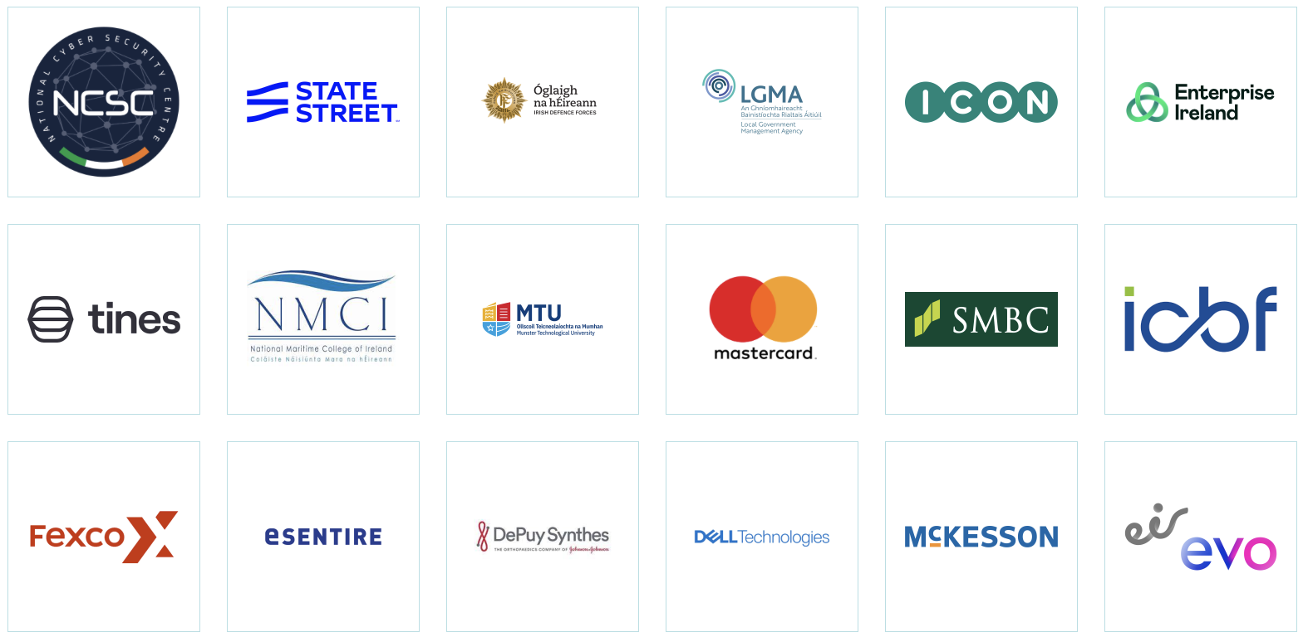
Immersive Environment Partners
Notes:
Try and get as many as possible on-board with different types of companies

Slide 59
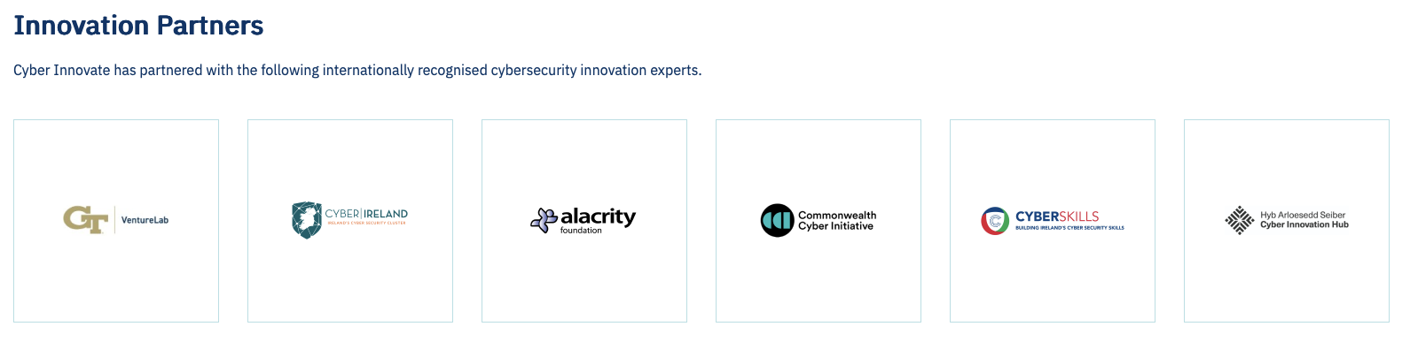
Innovation Partners &
Advisory Bords
Advisory board is really important
  Introductions to many types of stakeholders
  War stories on what has worked/didn’t work
  Recruitment – evangelists and ideas

Slide 60
Overall experience of participants
Year 1 – Very positive
Build in surveys for programme improvements
  Both students and immersive environment partners
  Act on the feedback where appropriate/possible
Regular 1 to 1 meetings (every 2 weeks, monthly is too long)
  Put into their diaries and meet them even if happy – only chance to see issues with Teams
Put in place assigned agreement with each student
  Don’t contradict RPO student polices – use them as base
  Build on top for specific requirements – attendance, other work/study, behaviour
Important to keep the faith
  “Trust the process” was our mantra

Slide 61


Questions????
ronan.coleman@mtu.ie
#euinmyregion
www.cyberinnovate.ie

Slide 62
Q&A Session

Slide 63
Q and A
Can an RPO that is currently hosting an Innovators' Initiative host a new programme?
Would EI facilitate RPOs with interest in a particular theme to come together for a more compelling proposition? Would this be preferable pre-application or be asked to join up post application?

Slide 64
Enterprise Ireland
East Point Business Park
The Plaza, Dublin 3
D03 E5R6
enterprise-ireland.com
+353 (1) 727 2000

