Slide 1


Trade, Tariffs and More
19th August 2025

Slide 2


Breaking News
"The EU will purchase $750 billion worth of U.S. energy, invest $600 billion more into the U.S. economy and buy American-made military equipment.” ​
​
“It’s a very powerful deal, it’s a very big deal, it’s the biggest of all the deals.”​
US President Donald Trump, July 2025

Slide 3
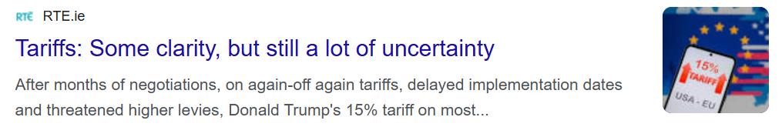

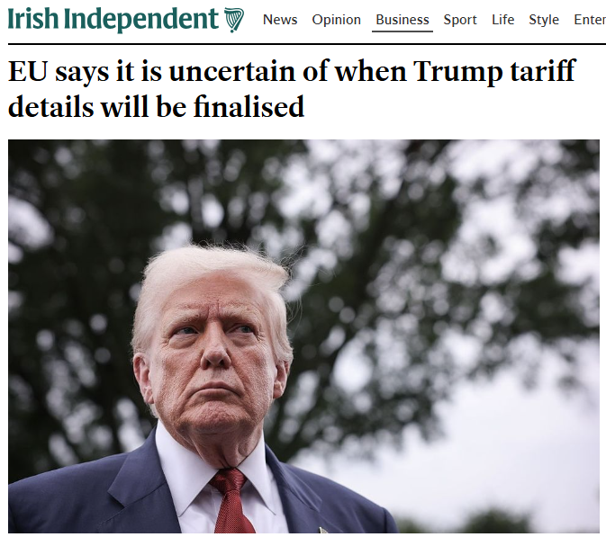
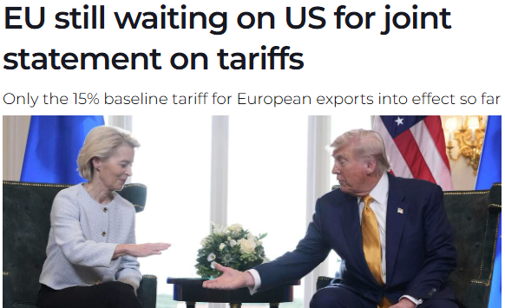
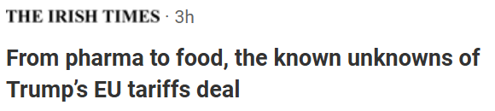
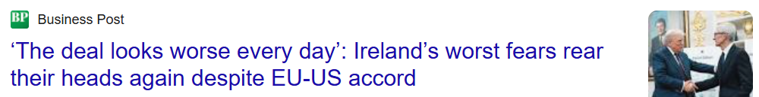
In the News

Slide 4


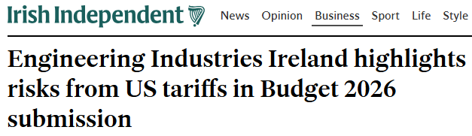
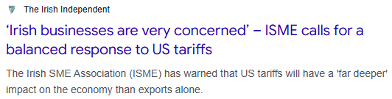


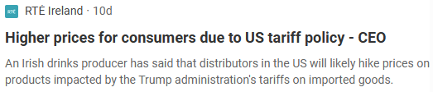
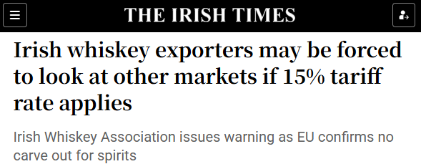

Impacts on Irish Business

Slide 5

Where did we come from – US Reciprocal Tariffs
Goods Potentially Exempt From Reciprocal Tariffs
Steel/aluminium articles already subject to Section 232 tariffs
Cars/car parts already subject to Section 232 tariffs
Copper
Pharmaceuticals (Medical devices not exempt)
Semiconductors
Lumber articles
All articles that may become subject to future Section 232 tariffs
Bullion
Energy and other certain minerals that are not available in the US
Articles subject to 50 USC 1702(b) (Communications, Donations, Informational Materials)
Minimum base level 10% tariff on all countries.
  This took effect from April 5, 2025
Individualized reciprocal higher tariff on the countries with which the United States has the largest trade deficits.
  This was due to take effect from April 9, 2025
Following President Trump's announcement on April 9, 2025, the increased reciprocal tariff rates were suspended for all countries except China, for 90 days.
On Monday July 7, President Trump signed an Executive Order adjusting the deadline for the imposition of “reciprocal tariffs” from July 9 to August 1.
A new Executive Order was signed on July 31 setting out additional tariffs for a range of countries above the 10% baseline.
On August 7, the revised reciprocal tariffs officially entered into force.
The Executive Order of July 31 referenced the US-EU framework deal and set out that the rates for EU originating goods are:
  15% for goods where the original MFN was below 15%
  If the MFN rate was 15% or higher, no additional tariff is applied

Slide 6
US Reciprocal Tariffs – where they landed
Country | Tariff Rate (August 7th)
EU | 15%
UK | 10%
Canada | 35% (non USMCA)
Brazil | 50%
Mexico | 25% (non USMCA)
Japan | 25%
China | 10% (rises to 34% after expiration of 90-day suspension started on August 12, 2025)
Switzerland | 39%
Australia | 10%
The US tariff rates are designed to make the terms of the bilateral trade relationships more reciprocal over time and to address the national emergency caused by the U.S. goods trade deficit.
In some instances, countries will be subject to a revised reciprocal tariff rate that is lower than the rate initially announced on April 2.
These new rates were confirmed in Annex I of the Executive Order of July 31 which confirmed they would enter into effect from August 7.
Only apply to non-US origin goods. Goods with at least 20% US-origin content are subject to the tariffs only in relation to the non-US origin content.
President Trump:
“If, for any reason, you decide to raise your tariffs, then, whatever the number you choose to raise them by, will be added on to the 25% that we charge”

Slide 7

Removal of the De Minimis
White House Announcement (July 30):
  The US will suspend the "de minimis" exemption.
  This previously allowed low-value commercial shipments to enter the country without tariffs.
In an Executive Order signed by President Trump, effective August 29:
  Packages valued at $800 or less, when shipped outside the international postal system, will be subject to all applicable duties.
  Packages shipped through the international postal system shall be subject to specific duty rates set out by CBP, either:
    Applying the ad valorem duty, based on the effective IEEPA tariff rate applicable to the country of origin (e.g. 15% for shipments from the EU), or
    A fixed amount per item, varying by the effective IEEPA tariff rate.
President Trump stated in the Executive Order:
  “Many shippers go to great lengths to evade law enforcement and hide illicit substances in imports that go through international commerce”. The risk of “evasion, deception, and illicit-drug importation are particularly high for low-value articles that have been eligible for duty-free de minimis treatment.”

Slide 8
Overview of the New Tariffs for the EU
On 27 July 2025, President of the European Commission, Ursula von der Leyen, and President of the United States, Donald J. Trump, reached a bilateral agreement on tariffs and trade relations between the European Union and the United States. Following this, on 31 July, President Trump signed an Executive Order entitled “Further Modifying the Reciprocal Tariff Rates” confirming that a rate of 15% would be applied to all EU goods from 7 August.
US Tariff Measures – Effective 7 August:
  A 15% import duty rate will apply to most EU products imported into the US.
  This rate includes the Most Favoured Nation (MFN) tariff and replaces any additional duties (exception for steel and aluminium).
  Where the MFN rate already exceeds 15%, the higher MFN rate will apply instead of the 15%.
The EU press release also contained information on the specific exemptions which would apply as part of this deal.
However, given the lack of any further publication from the US side implementing these exemptions, at present this remains a proposed list.

Slide 9




Tariff Exclusions and Specific Arrangements
The EU and US plan to continue discussions on expanding the list of products subject to adjusted tariffs.
Steel and aluminium
Tariffs on steel and aluminium remain at 50%. The EU and US are working towards establishing tariff quotas to allow a quantity of these products to be imported at a lower duty rate.
Cars and car parts*
  Tariffs on cars and car parts, previously up to 25% plus a 2.5% MFN rate, will be reduced in line with the 15% ceiling.
Chemicals, generic drugs, and natural resources*
  Tariffs on certain chemicals, generic drugs, and natural resources will return to pre-January levels.
Aircraft and aircraft parts*
  Aircraft and aircraft parts will revert to pre-January levels (pending US confirmation, discussed further below).
*Agreed but not implemented

Slide 10
UK/EU Trade Deal Comparisons
On the face of it, the UK's lower baseline tariff rate (10% vs 15%) could offer an advantage to UK-based firms competing with EU-based companies for sales into the US - allowing UK exports to be more competitively priced for the US market after the tariffs have been applied.
      "In principle, the UK is in a more advantageous position than other countries – so there is the potential to benefit from this," Michael Gasiorek, director of the Centre for Inclusive Trade Policy (CITP)
However, there are complexities in the two agreements and a lack of clarity around both, which make it tricky to compare them.
Feature | UK Deal | EU Deal
Baseline Tariff | 10% + MFN rates (effective rate can exceed 10%) | Capped at 15% total, unless MFN > 15%
Pharmaceuticals | No tariffs currently; preferential treatment promised | 15% tariff likely
Luxury Goods | MFN tariffs can reach 35% on top of 10% base | Capped at 15% total, unless MFN > 15%
Steel & Aluminium | Subject to 25% tariffs | 50% rate remains
Notes:
Tables

Slide 11
UK/EU Trade Deal Comparisons
Headline Tariff Rates:
UK-origin goods: 10% tariff on exports to the US
EU-origin goods: 15% tariff on exports to the US
EU-Origin good
$100.00
US Tariff rate
15%
Customs Duty
$15.00
While the UK’s agreement with the US sets a 10% tariff on many goods, this rate may not be the full story.
The 10% is applied on top of the existing US Most Favoured Nation (MFN) tariff for that product.
For example, if the MFN rate for a particular good is 7%, a UK exporter could face a combined duty of 17% (10% from the new agreement plus the 7% MFN rate).
This “stacking” of tariffs means that, despite the headline 10% rate appearing lower than the EU’s 15%, the actual duty paid by UK exporters could end up being higher, depending on the product and how the tariffs are applied.
UK-Origin good
$100.00
US Tariff rate
10%
Customs Duty
$10.00
UK-Origin Good
$100.00
10% + 7% MFN
17%
Customs Duty
$17.00

Slide 12


Aerospace
On July 29th, the EU published a press release on the EU-US deal, explaining that:
  "The key commitments of both sides include: As of 1 August 2025, US tariffs on EU aircraft and aircraft parts, certain chemicals, certain drug generics or natural resources will go back to pre-January levels."
This was in addition to a statement made on July 28th, by President Ursula von der Leyen, in which she explained that zero-for-zero tariffs have been agreed on several strategic products, "including aircraft and component parts".
However, this view was not necessarily reflected from the US side. In a Fact Sheet published by the White House on July 28th, no mention of a specific carve out for the aviation sector was made.
Since the implementation of President Trump's "Liberation Day" tariffs, any movement of EU-originating aircraft from the European Union to the United States was subject to a 10% tariff. Conversely, any movement of US-originating aircraft from the United States to the European Union was not subject to a retaliatory tariff. In theory, as a direct result of this deal, the movement of US- and/or EU-originating aircraft between each jurisdiction should be subject to 0% tariffs.
However, as outlined above, the most recent Executive Order states that EU-originating goods with an MFN Duty Rate of less than 15% will now be subject to reciprocal tariff rates of 15%.
In light of this, and given the lack of any further publication from the US side on specific exemptions, it is our understanding that the import of EU-originating aircraft and aircraft parts will be subject to a 15% tariff, until such a time that a specific US exemption list is published.

Slide 13

Pharmaceuticals & Medical Devices
A Section 232 Investigation, launched on 16 April by the US Department of Commerce, was initiated to determine the effects of imports of pharmaceuticals and pharmaceutical ingredients on national security.
The initial commentary from the EU, following the agreement reached between Commission President von der Leyen and President Trump, indicated that pharmaceuticals would be included within the 15% ceiling, should Section 232 measures be implemented.
However, comments made by President Trump seemed to run counter to this suggesting that tariffs on pharmaceuticals, when imposed, would be outside the scope of the recent EU – US agreement. In comments made in the days following the agreement, President Trump stated;
  “We’ll be putting an initially small tariff on pharmaceuticals, but in one year – one and a half years, maximum – it’s going to go to 150 per cent and then it’s going to go to 250 per cent because we want pharmaceuticals made in our country”
The US Administration subsequently did appear to clarify that there would be a 15% ceiling for EU origin pharma products once the Section 232 measures were introduced. However, this clarification has not yet been included in an Executive Order.

Slide 14


Other Sectors
The value of EU agrifood exports to the US, including products such as wine, totalled €48bn in 2024.
Food and beverage exports, including dairy (notably butter), spirits, and processed foods, are generally covered by the new 15% tariff, though some products like butter remain subject to higher pre-existing MFN rates where the existing rates exceeded 15%. Negotiations for further carve-outs are ongoing but not yet finalised.
Semiconductors, computers, and related technology products from the EU are now subject to a 15% US tariff ceiling if new measures are imposed.
Automotive exports such as cars and car parts now face a 15% tariff cap, down from previous rates as high as 25% plus 2.5% MFN, standardising the rate but still marking a significant increase from earlier years (should the new measures be imposed).
The EU's press release on the EU-US deal from July 29th stated that for 'strategic products';
  "As of 1 August 2025, US tariffs on EU aircraft and aircraft parts, certain chemicals, certain drug generics or natural resources will go back to pre-January levels."
However, as outlined previously, there has been no further publication from the US side implementing these exemptions, so uncertainty still exists around the future impact on these sectors.

Slide 15

Key Impact Levers to Reduce Tariff Exposure
Stockpile inventory
First Sale/
Country of Origin/
Free Trade Agreements
Duty Drawback
(5-year retro opp)
'Chapter 98' reliefs
Supplier Negotiations – lock in costs
Alternative
Valuation
Tariff Classification/
Exclusions or Exemptions
Free Trade Zones (FTZ)
Existing Supply Chain
Modified Supply Chain
Supplier/Customer Pricing and Negotiations
Trade Policy Consulting & Customer Messaging
Site selection
Product Flows/ Alternative materials
Supply Chain Footprint – change or diversify

Slide 16
Questions?
August 2025

Slide 17









Global Trade & Customs - Meet the team
Paul Rodgers
Director
EI - Point of Contact
paul.rodgers@pwc.com
John O’Loughlin
Partner
john.p.oloughlin@pwc.com
Mark Brennan
Director
mark.p.brennan@pwc.com
Nick Koolen
Director
nick.x.koolen@pwc.com
David Lusby
Senior Manager
david.lusby@pwc.com
Ben Twomey
Senior Manager
ben.twomey@pwc.com
Kathy Doyle
Senior Manager
kathy.doyle@pwc.com
Alicia Suarez
Manager
alicia.montserrat.x.suarez@pwc.com
Jonathan Burke
Manager
jonathan.x.burke@pwc.com
The PwC Global Trade and Customs Team is the largest customs advisory team in Ireland with 19 members from a variety of backgrounds. We provide a wide range of customs, excise and export control advisory services to importers and exporters who operate global supply chains. The team provides clients with practical, commercial advice to support their compliance with customs and trade requirements and to help them to minimise duties and other costs associated with cross border trade. ​
​
We support both domestic and multinational clients across multiple industries (including Agri-food, Pharmaceuticals & Medical Devices, Technology, Retail and Consumer Products, Industrial Manufacturing and Public Sector) and use our understanding of sector-specific issues to tailor our advice to client needs. The team itself prides itself on keeping up-to-date with customs and trade developments and on providing advice that is relevant, insightful and commercial.

Slide 18
Thank you
© 2025 PwC. All rights reserved. PwC refers to the PwC network and/or one or more of its member firms, each of which is a separate legal entity. Please see www.pwc.com/structure for further details. This content is for general information purposes only and should not be used as a substitute for consultation with professional advisors.

